Slide 1
ESE 224 - Final Project:
Text-Adventure Game
Due: December 2 (4 Weeks)
Notes:
November 25 (34 Weeks)

Slide 2
Task 0
Add the operator overload for the operator<< in player class and enemy class
Remember to use “friend”
Example:
.h file
.cpp file

Slide 3
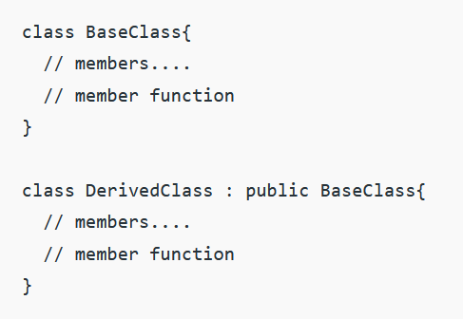
Task 0
Turn the enemy class into a derived class of Player Class. This means that Player Class is a base class.

Slide 4
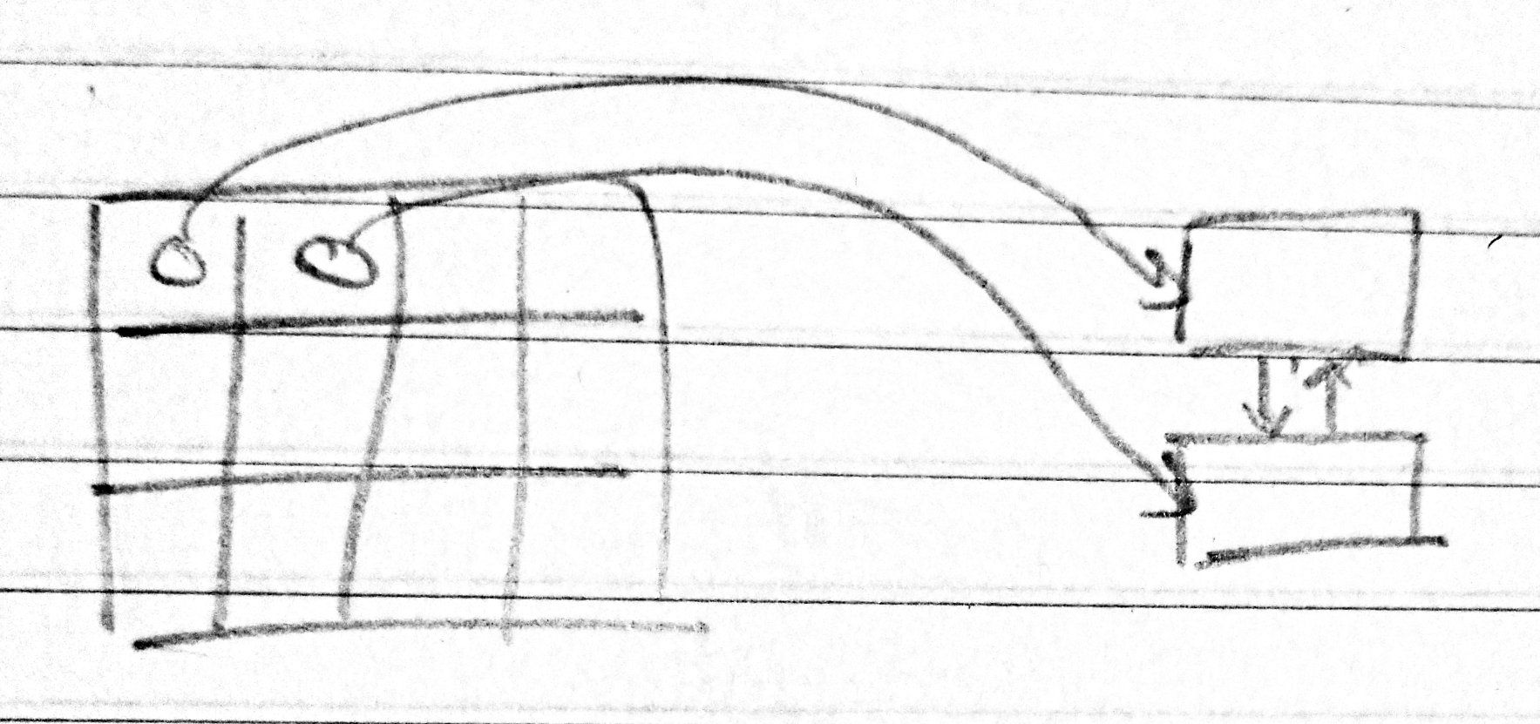
Task 1
Modify the “shop” so that it utilizes a double-linked list. This list is different from the player weapon inventory list.
Add weapons to this list. Use the insert function from earlier.
Uses the print function from earlier.
Continue to add weapons after every floor. The list should eventually display the whole 2D matrix in the end.
Weapons
Shop

Slide 5
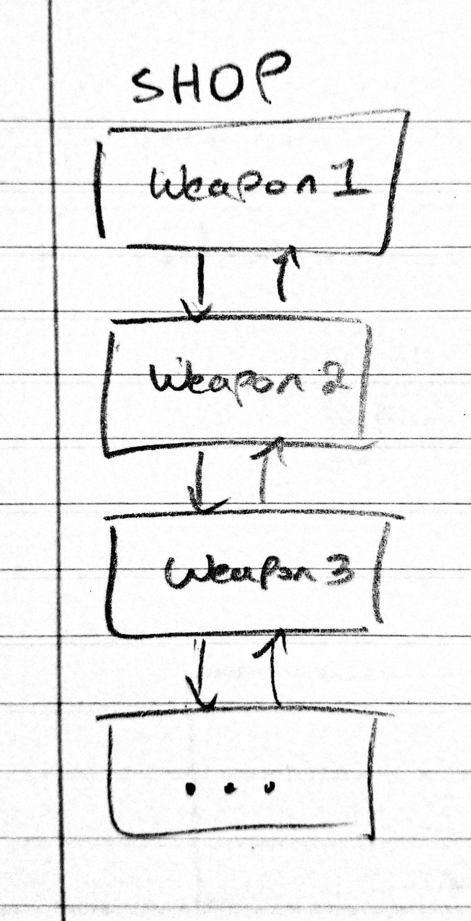
Task 1
The shop should now be a list.

Slide 6
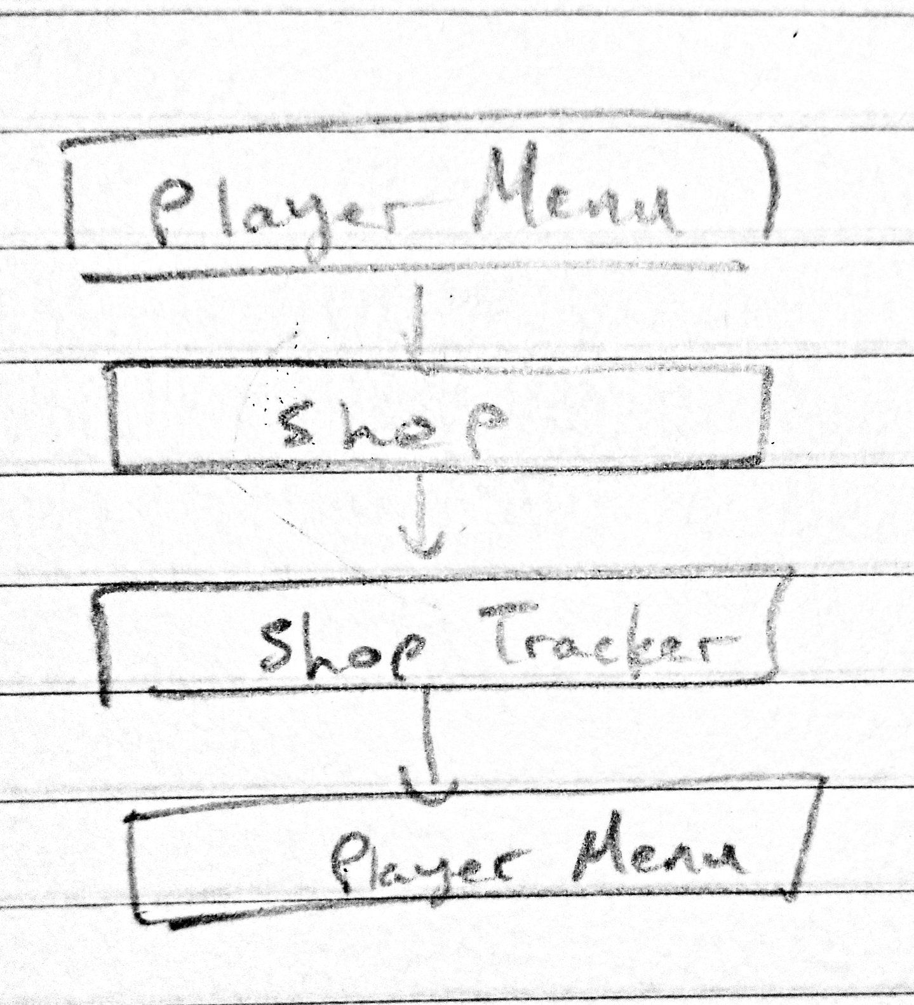
Task 2
Track the all the weapons bought from the shop. Once a player leaves the shop the stack should be outputted.
Create a print function to output the entire stack. Output from the top to bottom.
Create a clear function to delete the entire stack (call this at the end of the program to prevent dangling pointers)

Slide 7
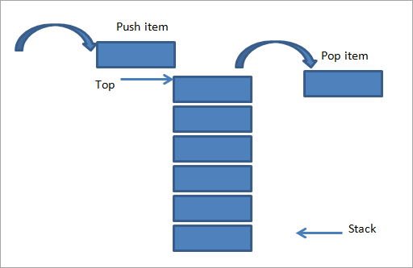
Task 3
Create a stack that holds the enemies defeated
Use Stack class template
Create a insert function to add an enemy object to the stack
Create an operator overload of the operator<< to print the names and level of the entire stack
Create a function to clear the whole stack

Slide 8
Task 4
Create a list data structure to store the scoreboard data using the class template
Create a load function
Create an insert function
Create an insertion sort function
Create a search function to find names
operator overload of the operator<< to print the whole list
Give the user a menu to choose to sort by score, sort by name, or search for a name
Use the class template clear at the end of the program to delete the list

Slide 9
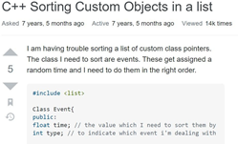

Task 4.5
Overload the sort function of list.
Create a sort function to sort the list by score.
Create a sort function to sort the list by name.
Operator overloading the operator< and creating a custom compactor is recommended but not required
You can use a lambda function, like in the lab.

Slide 10
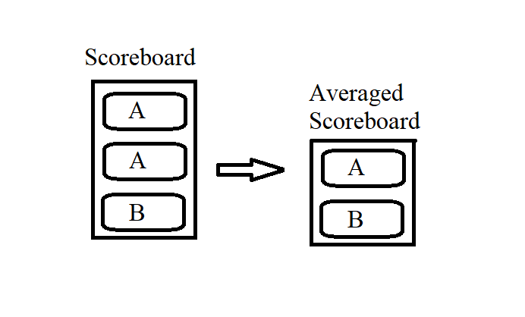
Task 5
Create a new list for averaged scores from the scoreboard
This function should display a list of averaged player scores
Search the list for duplicate names
Average the scores of duplicate names
Sort all averaged scores
Print list

Slide 11
Task 6
Create side-quests for the player to complete. Once the player completes this side-quest, give the player bonus points to be added onto the player’s score.
Ask the player to do a task. (It could be anything. Examples on next slide.)
Check at the end of the floor if the side-quest was completed.
Create a queue.
For every side-quest completed add a string phrase that notes what the side-quests that were completed.
At the end of the game, before the player score is displayed, print out the phrases in the queue to show what side-quests the player completed.

Slide 12
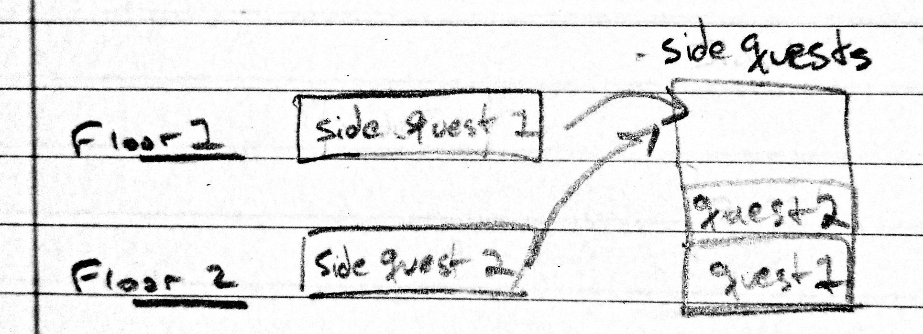
Task 6
Examples
Save up a certain amount of currency. (e.g. Save 100 coins)
Don’t buy a new weapon. Defeat the enemy only using your free weapon.
End a battle with more than 50% health.
Have attack damage higher than your current health.

Slide 13
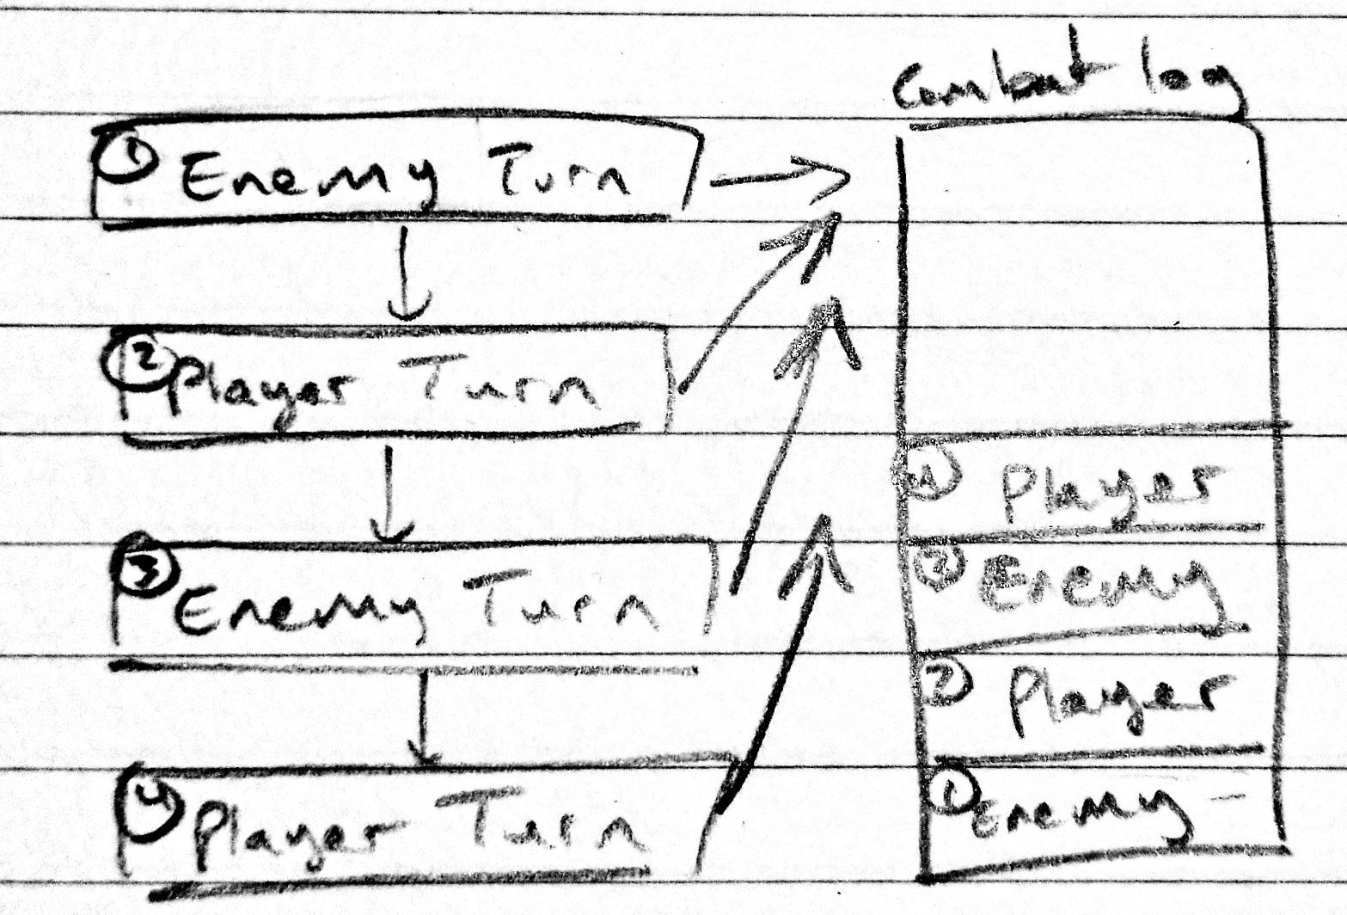
Task 7
Create a combat log. Track the health of the enemy and player during combat.
After a player or enemy’s turn, copy the current health to a stack to show the player at the end of the combat encounter.

Slide 14
Task 8
Control the enemies the player encounters.
Create an array of enemies. Then put the enemies that you already have into the array.
Create a queue using the class template. Weakest enemies at the front and stronger enemies towards the back.
Move the enemies from the array into the queue.
Before combat, call an enemy from the queue.
After combat, remove the enemy from the queue

Slide 15
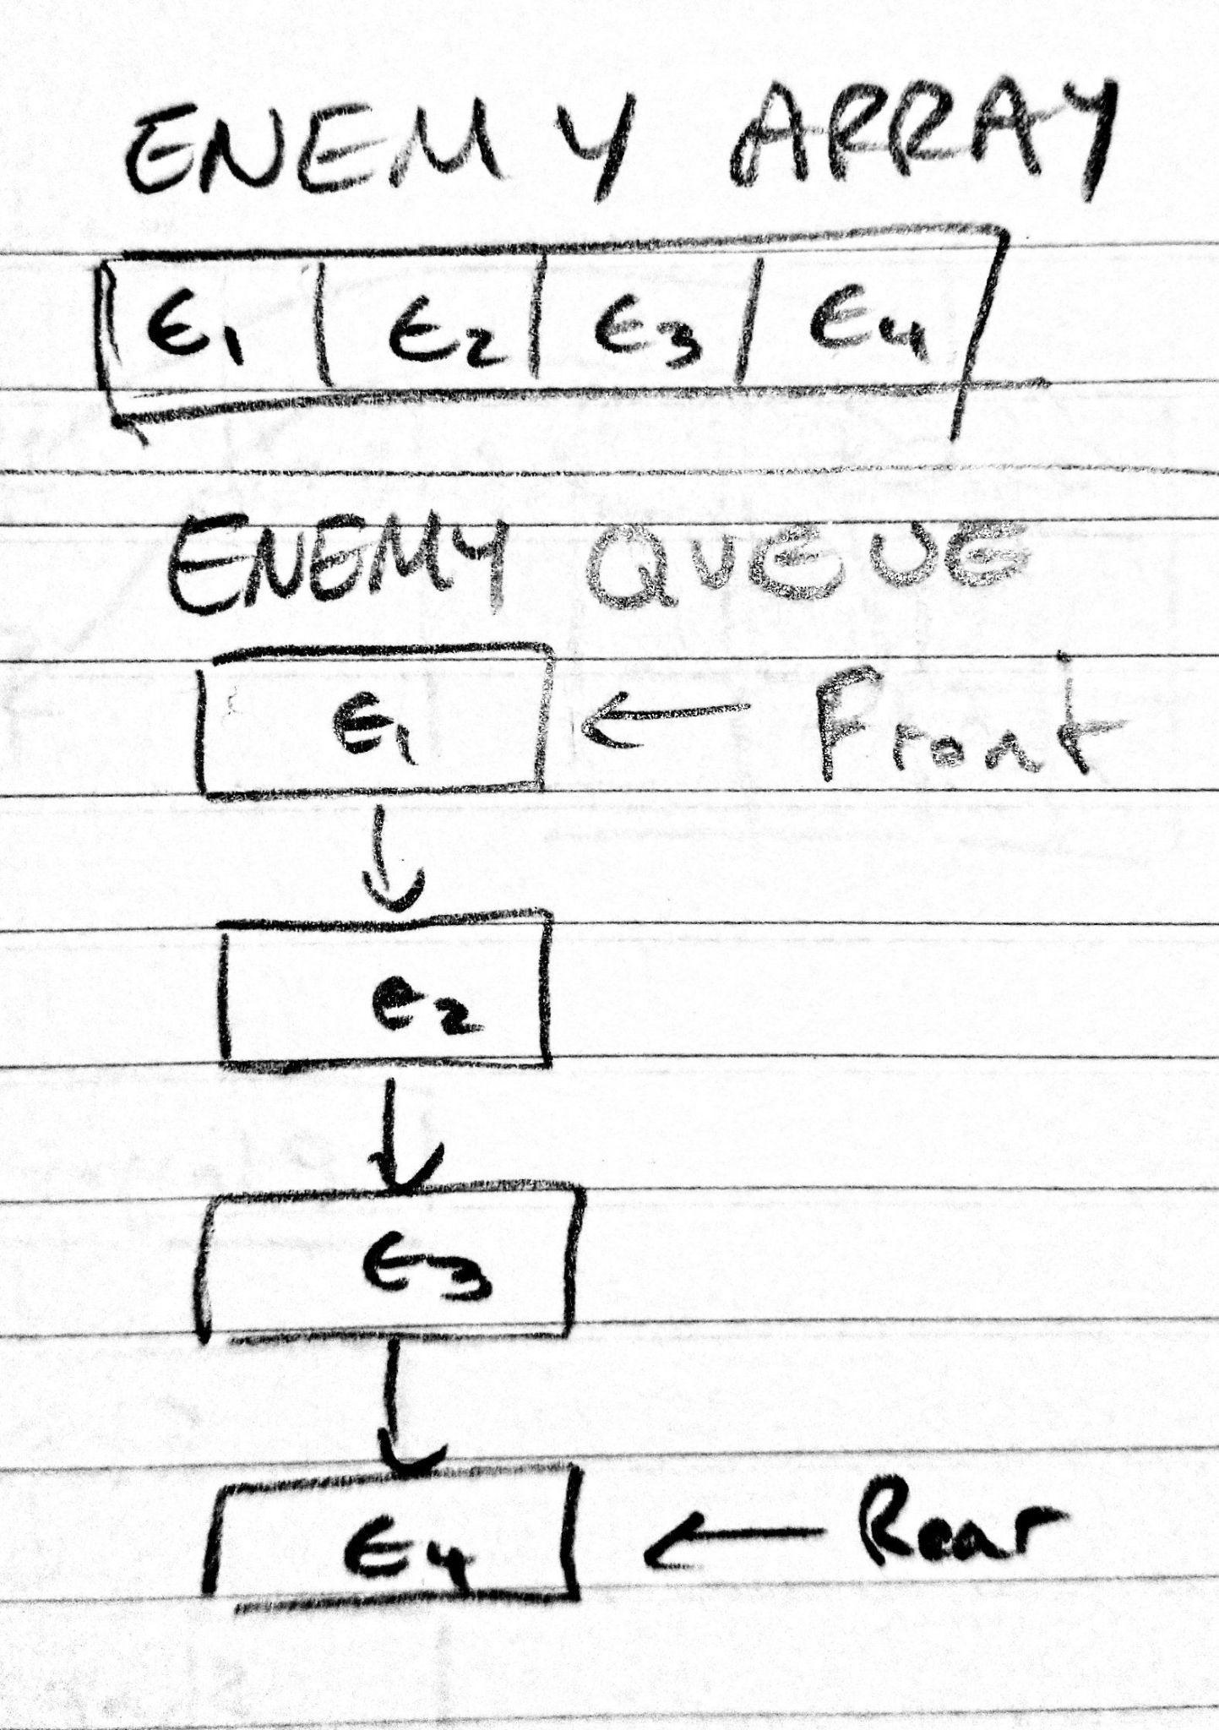
Task 8
The array forms the queue

Slide 16
Bonus
You can earn a maximum of 10 points bonus. Choose the bonus task.
Bonus (10 points)
Keep the mid-term structure and sort the scoreboard vector using heap sort.
Bonus (10 points)
Use a binary search tree to track the score board. In the binary search tree, you have three optional orders of operation. (In-order, Pre-order, and Post-order Implementation)

